Slide 1
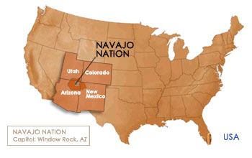
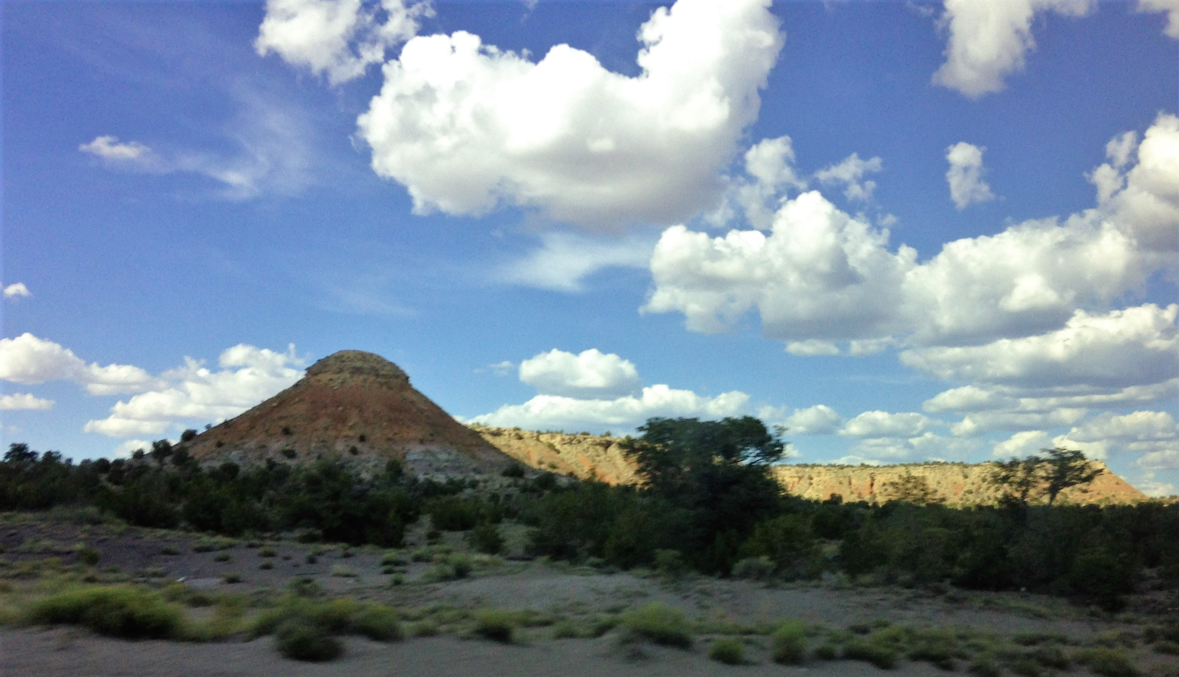
Examining Perspectives of Researchers Regarding Genetic Research on the Navajo Nation
Carissa Sherman, Graduate Student
carissa.sherman@cuanschutz.edu
University of Colorado Anschutz Medical Campus
Katrina G. Claw, PhD
University of Colorado Anschutz Medical Campus
Nanibaa’ A. Garrison, PhD
University of California, Los Angeles
Contact: navajogenetics@gmail.com
(Photo taken by Carissa Sherman, Ganado, AZ)
Perspectives on Genetic Research in the Navajo Nation Project (NNR-17.281)
Notes:
Hello everyone, my name is Carissa Sherman. I am a PhD student in the human medical genetics and genomics program at the University of Colorado Anschutz Medical Campus. I am happy to be here today.
I will be presenting on my project, “Examining Perspectives of Researchers Regarding Genetic Research on the Navajo Nation.”
The Navajo Nation is located within the four-corners region of the US. The photo below is from Ganado, Arizona where my grandma lives. I would like to take the time to introduce myself in Navajo
[introduce self]. We introduce our clans and where our family is from to build and connect to our community.
It is great to be a part of a project relevant and working with my community. This project is also a part of a larger effort, “Perspectives on Genetic Research in the Navajo Nation,” led by co-PIs, Drs. Claw and Garrison.

Slide 2
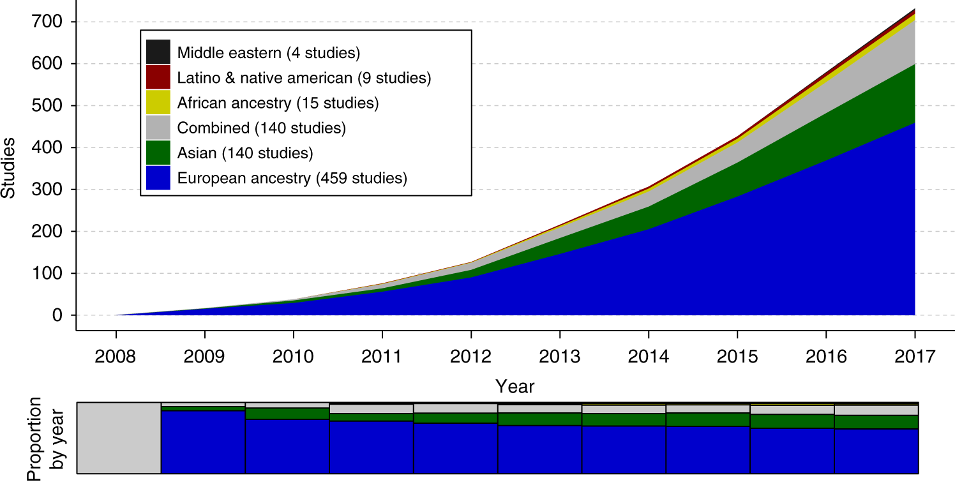
Low-representation of historically underrepresented populations—including Indigenous peoples – in genetic studies
(Duncan et al., 2019)
Notes:
There is an oversampling of populations of European descent, which results in a biased understanding of which genetic variants are important
Indigenous peoples are historically and currently underrepresented in genetic research studies.

Slide 3
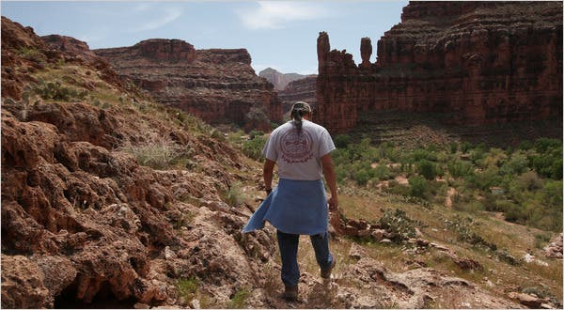
Potential reasons for low Indigenous representation in research
Historical mistrust
Potential challenges to personal and cultural norms
Other health, social, and economic priorities
Control and storage of data
(The New York Times, 2010)
Notes:
Historical mistrust from research abuses, stigmatization, discrimination, and broken promises
Concerns that the interpretation of the results challenges one’s personal and cultural norms
Other health, social, and economic priorities
Lack of control over secondary uses of data
Concerns about how data or biospecimens will be handled after research projects end or after a participant’s death
Many of these issues are touched upon in the work/research that impacted the Havasupai

Slide 4
Impacts of having low-representation of Indigenous populations in genetic studies
May not benefit from genetic studies
Potentially exacerbate health disparities
Indigenous researchers & knowledge undervalued (Gewin, 2021)
Notes:
Under-represented populations have historically – and currently - experience health care disparities at disproportionate rates, and if they are not well represented in current or future research, additional health care inequalities could arise.

Slide 5
“The Mission of the Navajo Nation Human Research Review Board [NNHRRB] is to support research that promotes and enhances the interest and the visions of the Navajo People”
(NNHRRB, 2005)
Notes:
To provide background into how research is done within the Navajo Nation, it is important to note that the Navajo Nation has sovereignty; we are self-governing. We have our own internal review board (IRB), the Navajo Nation Human Research Review Board (NNHRRB). I will refer to the NNHRRB as the Navajo IRB for brevity.
The Navajo IRB was founded in 1996 to guarantee ethical research for the Navajo people. The Mission of the Navajo Nation IRB is to support research that promotes and enhances the interest and the visions of the Navajo People.

Slide 6
A moratorium on Genetic Research conducted within the Navajo Nation was approved in April 2002.
The LIFE Images Collection, 1948
Notes:
While all research conducted on Navajo Lands go through the Navajo IRB, there has been a moratorium – or essentially a ban – on genetic research studies (with humans) conducted on the Navajo Nation since 2002. This ban was put in place partly due to concerns about historical distrust, exploitation, and limited expertise and resources (Claw et al., 2021). Another crucial reason is that Navajo leaders, healers, scientists, community members recognized a lack of policies for genetic research protocols. This moratorium is still in place.
This project aims to provide an additional perspective to help guide potential genetic policies as well as help leaders and community members have the perspectives of researchers with Navajo IRB approved projects.

Slide 7
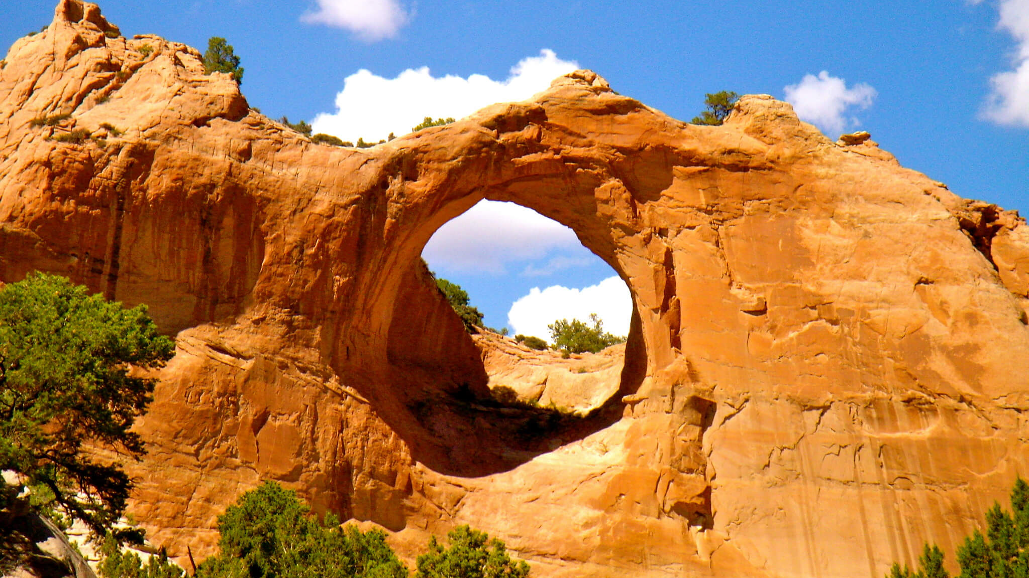
Research Question: How do researchers with NNHRRB-approved projects perceive genetic research on the Navajo Nation?
(Arizona, 2016)
Notes:
Our research question is: “How do researchers with Navajo-IRB approved projects perceived genetic research on the Navajo Nation?”
For today’s presentation, I will focus on if researchers could foresee adding a project, as well as identify benefits, risks, and ethical considerations in the context of genetic research on the Navajo Nation.

Slide 8
Methods
Online survey
Recruitment
Analysis
Notes:
We utilized a mixed methods approach. We developed and distributed an online survey via Qualtrics with qualitative and quantitative questions. We recruited researchers from a list of Navajo IRB approved projects. We contacted 70 participants and received full responses from 36. We then conducted analyses using excel and R. I will present some summary statistics and thematic analyses of open-ended responses.

Slide 9
Recruitment Process
182 NNHRRB projects – 3/2021
Sent personalized emails 1x month
46 responses
70 total contacts
https://www.nnhrrb.navajo-nsn.gov/aboutNNHRRB.html
11 referrals
Filtered based off biological/biomedical topics
Removed responses:
Did not complete (n=6)
Did not qualify (n=4)
59 contacts
Topics
Immunology | Bacterial
Environmental | Asthma
Diabetes | Cancer
Vaccine | Microbiome
Health | COVID-19
36 total responses
(Begay et al., 2020)
100 projects
Notes:
Bacteria/Virus Genetics
Blood and HLA
Complex Diseases
Forensics
Hereditary Diseases
Population Genetics/Migration
“Respondents were not required to complete all questions.” So, we kept individuals that I had completed at least 70%

Slide 10
Demographics (n=33)*
Race/Ethnicity
White or of European Descent | 21 | 64%
Diné (Navajo) | 9 | 27%
American Indian or Alaska Native | 1 | 3%
Asian or Asian American | 1 | 3%
Hispanic or Latino | 1 | 3%
*n=3 did not include demographic information
Notes:
In looking at the demographic of researchers, or our participants, a majority were between the ages of 40 and 59, most (64%) identified as women, and a majority were White or of European descent followed by Navajo researchers. This helps to contextualize who are participants are.

Slide 11
If the moratorium on genetic research ends, can you foresee adding a genetics component to your project(s)?
N = 36
“[Genetics] is needed to translate information about genes and sequences into knowledge about genetic susceptibility to disease…”
“While genetics is not my area of research/expertise, it would be an area to explore as it relates to childhood [AI/AN] obesity”
“Our project is currently entirely anonymous and I would not want to add any component that would include identifying information.”
Notes:
We wanted to gauge if researchers could foresee adding a genetics component to their projects. Here, we see a bar graph with the responses “Yes, Unsure, and No” with the count on the other axis. Most participants indicated that there were unsure at 42% followed by yes, 31%, and no at 28%. I also wanted to provide exemplary quotes to help us better understand the range:
“[Genetics] is needed to translate information about genes and sequences into knowledge about genetic susceptibility to disease…”
“While genetics is not my area of research/expertise, it would be an area to explore as it relates to childhood [AI/AN] obesity”
“Our project is currently entirely anonymous and I would not want to add any component that would include identifying information.”
These quotes provide data into some motivations of whether or not to add a genetics aspect into Navajo-IRB approved projects in a hypothetical manner.
What are some of the factors that could influence whether or not to add a genetics component?
Exploratory vs hypothesis testing = what kind of projects do we want to allow → something that has more

Slide 12
What are the potential benefits and risks to Navajo people of including a genetic component in your research?
Benefit: Importance and potential of health research
Risk: Need to consider cultural aspects
“…It is possible that researching the specific needs for Navajo people could lead to better prevention and treatment.”
“Biggest potential risk is how this may contradict people's cultural values and belief systems”
Notes:
Well, here is an example of one benefit and one risk – although several more were identified.
A potential benefit of including genetics, would be genetics is important for to improve potential health research. Here is a quote that exemplifies this theme:
“…It is possible that researching the specific needs for Navajo people could lead to better prevention and treatment.”
A potential risk identified of including genetics highlighted the need to consider cultural values. A quote that exemplifies is: “Biggest potential risk is how this may contradict people's cultural values and belief systems”
We have identified how researchers perceive benefits and risks of genetic research, we also evaluated ethical considerations.

Slide 13
If the moratorium on genetic research ends, how important are each of the following aspects for doing research with the Navajo community?
Community Engagement
Dissemination of results and data
Privacy and rights
Health, safety, and equity
Discrimination and mistrust
Notes:
We asked participants, “If the moratorium on genetic research ends, how important are each of the following aspects for doing research with the Navajo community?”
In this section, we provided respondents 5 broad areas – but I am only showing two today, “Community Engagement” and “Dissemination of Results and data”. Each of these areas had 4 statements of ethical considerations that participants were asked to rank. These themes and statements were derived from a previous project.

Slide 14
Community Engagement
N = 32, 4 did not respond
Most Important 2 3 Least Important
Building trust with the community is one of the most important considerations
Notes:
The range is from most important to least important. However, if a statement is ranked as least important, this does not mean it isn’t important. The statements that people had to rank were “Building trust,” “Being transparent,” “Involving community members in the process,” and “Including Navajo cultural beliefs.” We can see the distributions of the rankings, and we can identify that “Building trust with the community is one of the most important considerations.”

Slide 15
Dissemination of results and data
N = 33, 3 did not respond
Most Important 2 3 Least Important
Giving presentations to the community is one of the most important considerations
Notes:
This slide is similar to the last. The ranking from most to least is shown here. The statements were:
“Giving presentations,” “Writing short reports in lay language,” “Publishing accurate and appropriate information,” and “sharing data with other researchers.” We can see some spread in the rankings, but “Giving presentations to the community arises as one of the most important considerations.”

Slide 16
Community Engagement ranking by race/ethnicity
BIPOC: Black, Indigenous, or Person of Color; N = 32 (Non-BIPOC=20, BIPOC =12), 1 did not respond
Most Important 2 3 Least Important
Building trust with the community | Non-BIPOC
 | BIPOC
Being transparent about the research plan | Non-BIPOC
 | BIPOC
Involving community members in the research process | Non-BIPOC
 | BIPOC
Including Diné cultural beliefs | Non-BIPOC
 | BIPOC
Building trust with the community is ranked higher by BIPOC participants and Involving community members is ranked higher by Non-BIPOC participants
Notes:
How it breaks down by demographics (whether or not see any trends) -> including cultural beliefs
Colors around
Centering with alignment and switch colors of most and least important
Ends as darker colors
Because 3 individuals did not give demographic individual, max n = 33

Slide 17
Dissemination of results and data ranking by race/ethnicity
BIPOC: Black, Indigenous, or Person of Color; N = 33 (Non-BIPOC=21, BIPOC =12)
Most Important 2 3 Least Important
Giving presentations to the community | Non-BIPOC
 | BIPOC
Writing short reports in lay language for the community | Non-BIPOC
 | BIPOC
Publishing accurate and appropriate information | Non-BIPOC
 | BIPOC
Sharing data with other researchers | Non-BIPOC
 | BIPOC
Giving presentations to the community is ranked higher by Non-BIPOC participants and Publishing accurate information is ranked higher by BIPOC participants
Notes:
Think about the deliberations and how they had grouped (limitations/discussion of results)

Slide 18
Conclusions
Designed online survey, distributed to PI’s with NNHRRB-approved projects
Showed summary counts and thematic analyses
Genetic policies are needed
“I applaud the work you are doing to understand the community readiness and desire to include genetic research. The decision must come from within the community.”
Notes:
In drawing to a conclusion, we designed an online survey and recruited researchers with projects approved by the Navajo IRB. Today we discussed how researchers perceive genetic research by first identifying if they could foresee adding a genetics component, second by looking at a potential benefit and risk of including genetics, and finally by characterizing the “most important” ethical considerations if the moratorium on genetics research ended.
The data generated from this project contributes to our knowledge of how genetics is perceived from researchers, which supplements other efforts of the lab.
Additionally, our findings can help guide tribal leaders and potentially help with developing a future genetic policy.
I want to leave us with this quote that inspires and reminds me of the importance of our work, and the value of ensuring community involvement.

Slide 19
Acknowledgements
Ahéhee’ – Thank You
Our Research Team
The Claw Lab and its members:
Amber Nashoba
Leah Nez
Kaja Aagaard
Tada Vargas
Navajo Nation Genetic Research Policy Development Working Group
Honorable Council Delegate Jamie Henio (24th NNC)
Former Council Delegate Walter Phelps (23rd NNC)
Navajo Nation Human Research Review Board
Navajo Government Development Office
Navajo Department of Health
Funding
Seattle Children’s Hospital
Pediatric Pilot Fund
Health Equity Fund
Treuman Katz Center for Pediatric Bioethics
University of Washington
Information School
National Institutes of Health
K01 Research Scientist Development Award (Garrison)
F32 Postdoctoral Fellowship (Claw)
RM1 Administrative Supplement Award (Garrison)
NHGRI R25 (Claw)
NARCH pilot grant (Claw and Garrison)
Project email: navajogenetics@gmail.com
Personal email: carissa.Sherman@cuanschutz.edu
Notes:
I would like to acknowledge and thank our research team, the Claw lab and its members, my program Human Medical Genetics and Genomics, several Navajo entities and our funding resources. Ahéhee’ – Thank you. And with that, I will take any questions.

Slide 20
References
Begay, R. L., Garrison, N. A., Sage, F., Bauer, M., Knoki-Wilson, U., Begay, D. H., Becenti-Pigman, B., & Claw, K. G. (2020). Weaving the Strands of Life (Iiná Bitł’ool): History of Genetic Research Involving Navajo People. Human Biology, 91(3), 189–208. https://doi.org/10.13110/humanbiology.91.3.04
Claw, K. G., Dundas, N., Parrish, M. S., Begay, R. L., Teller, T. L., Garrison, N. A., & Sage, F. (2021). Perspectives on Genetic Research: Results From a Survey of Navajo Community Members. Frontiers in Genetics, 12, 734529. https://doi.org/10.3389/fgene.2021.734529
Duncan, L., Shen, H., Gelaye, B., Meijsen, J., Ressler, K., Feldman, M., Peterson, R., & Domingue, B. (2019). Analysis of polygenic risk score usage and performance in diverse human populations. Nature Communications, 10(1), 3328. https://doi.org/10.1038/s41467-019-11112-0
Gewin, V. (2021). How to include Indigenous researchers and their knowledge. Nature, 589(7841), 315–317. https://doi.org/10.1038/d41586-021-00022-1
Navajo Nation Human Research Review Board. (n.d.). Retrieved September 26, 2022, from https://nnhrrb.navajo-nsn.gov/aboutNNHRRB.html

